Slide 1
ASTU
Computer Science & Engineering (CSE)

Slide 2

CSEC-ICPC
Presented by: Yohanes Fikru

Slide 3
OUTLINE
#1
What is CSEC?
#2
What is ICPC?
#3
WHY ACM-ICPC?
#4
THE CONTEST
#5
2018 WORLD FINALS
#6
The Entrance exam

Slide 4
#1. What is CSEC?
CSEC stands for Computer Science and Engineering Club
CSEC has 3 Divisions...namely CSEC-ICPC, CSEC-Dev't and CSEC-Capacity Building.
CSEC
CSEC-ICPC
CSEC-Dev't
CSEC- Capacity Building

Slide 5
CSEC-ICPC
CSEC-ICPC is the division that conducts Competitive programming and aims to prepare students for the International Collegiate Programming Contest (ICPC)

Slide 6
#2. what is ICPC?
I
C
P
C
INTERNATIONAL
COLLEGIATE
PROGRAMMING
CONTEST
Multi-tiered
University/college students
Problem Solving
Computation

Slide 7
#3. Why ACM-ICPC?
01
Help students Interact with students from other universities.
A platform to encourage the next generation of computing professionals..
03
To sharpen and demonstrate students problem solving skill.
02

Slide 8

ACM ICPC TIERS
1
2
3
NATIONAL
REGIONAL
WORLD

Slide 9
ACM ICPC REGIONALS
EUROPE
ASIA
NORTH AMERICA
SOUTH PACIFIC
LATIN AMERICA
AFRICA/MIDDLE EAST

Slide 10
ACM ICPC History
ACM hosted the first World Finals
Michigan State University won
1970
1989
1977
Local Contest held at Texas A&M
UPE Computer Honor Society
Contest headquarters have been located at Baylor University.

Slide 11



ACM ICPC History
CONTESTANTS
49,935
2017
UNIVERSITIES
3,098
COUNTRIES
111

Slide 12
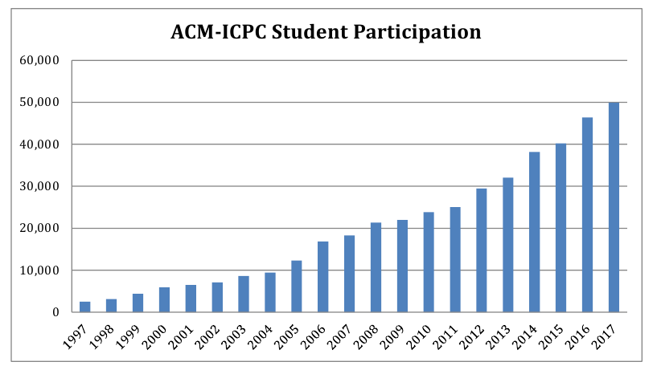
ACM ICPC History
SUPERLINER GROWTH

Slide 13





WHY ACM-ICPC?
To Host World Final
Cities invest Millions of Dollars
ICPC
Extremely prestigious
Winners get cash prize
Russian Universities
Champions get $15,000
Gold medalists - $7,500
Broadcasted Live
World Finals On Television
Silver - $6,000
Bronze - $3,000

Slide 14
WHY ACM-ICPC?
An outlet for top students
1
4
Learn to code and work in team
Easier to find a job!
2
5
Regional winners invited to week-long world finals
Learn Many useful algorithms, mathematical insights
3
6
It is also fun

Slide 15
Contest Organization
LOCAL
REGIONAL
WORLD
University Competitions
Typically 50-100 Teams
Up to 100 teams invited
Run by Regional contest staff
IBM Sponsorship started in 1997
Run by Local Staffs
Regional Winners get to go to World Finals
Held in different country each year

Slide 16
WORLD FINALS Hosts
Marrakech, Morocco
South Dakota, USA
2014
2016
2018
2015
2017
Yekaterinbug, Russia
Phuket, Thailand
Beijing, China

Slide 17
#4. The Contest

Slide 18


Contestant Eligibility
A STUDENT
Enrolled in a degree program at the team’s institution
May compute for only one institution during a contest year
Who has computed in two world finals is NOT eligible to compete
Who has computed in five Regional Contests is NOT eligible to compete

Slide 19
Contestant Eligibility
All team members must attend all contest activities as it result in automatic disqualification
The coach and all team members must be fully registered at the ICPC Registration System BEFORE computing in a regional event.

Slide 20





THE CONTEST
TIME
4-5 Hours
TEAM
BALLOON
3 STUDENTS
Each problem is associated with a color
COMPUTER
One Computer per team
PROBLEMS
8 - 13

Slide 21
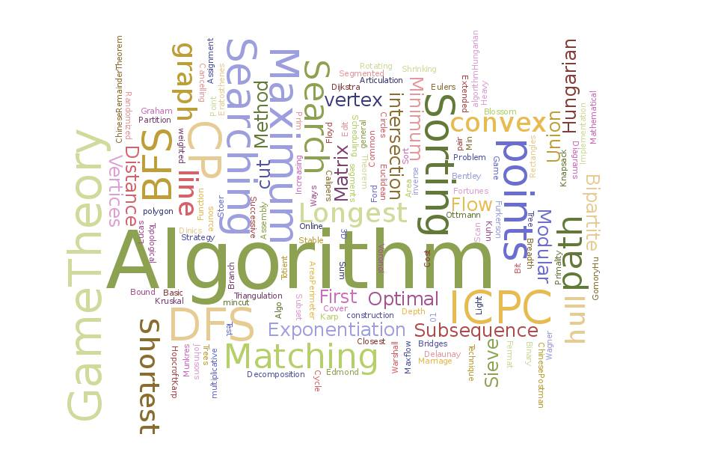
THE CONTEST
while ( ! isTimeout() ) {
read();
think();
program();
//debug();
submit();
}

Slide 22
CONTEST RULES
01
No other electronic devices or internet allowed
02
Not allowed to convers with anyone except team members
03
Judge by some test cases
Pass all test cases = solve the question
If fail, can resubmit
04
Can submit a clarification request to a judge
05
Winner is the team that solves the most problems in the least time!

Slide 23


Slide 24

ONLINE JUDGE
AC
PE
WA
CE
Accepted
Presentation Error
Wrong Answer
Compiler Error

Slide 25
ONLINE JUDGE
RE
TL
ML
Runtime Error
Time Limit Exceeded
Memory Limit Exceeded

Slide 26
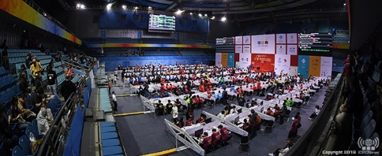
#5. 2018 WORLD FINALS

Slide 27
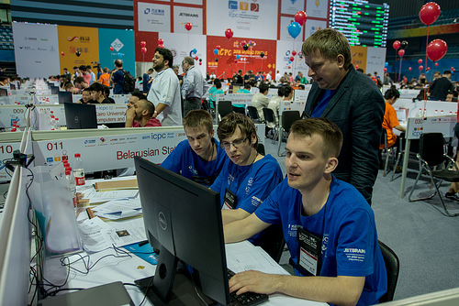

Slide 28
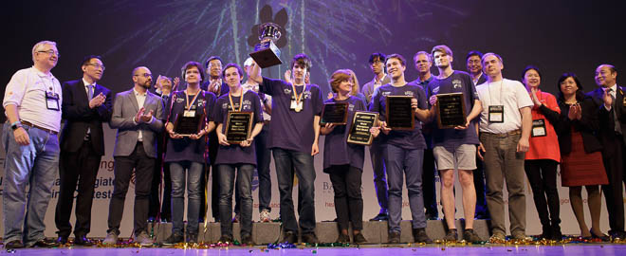
MOSCOW STATE UNIVERSITY - 2018 ACM-ICPC World Finals Champions

Slide 29
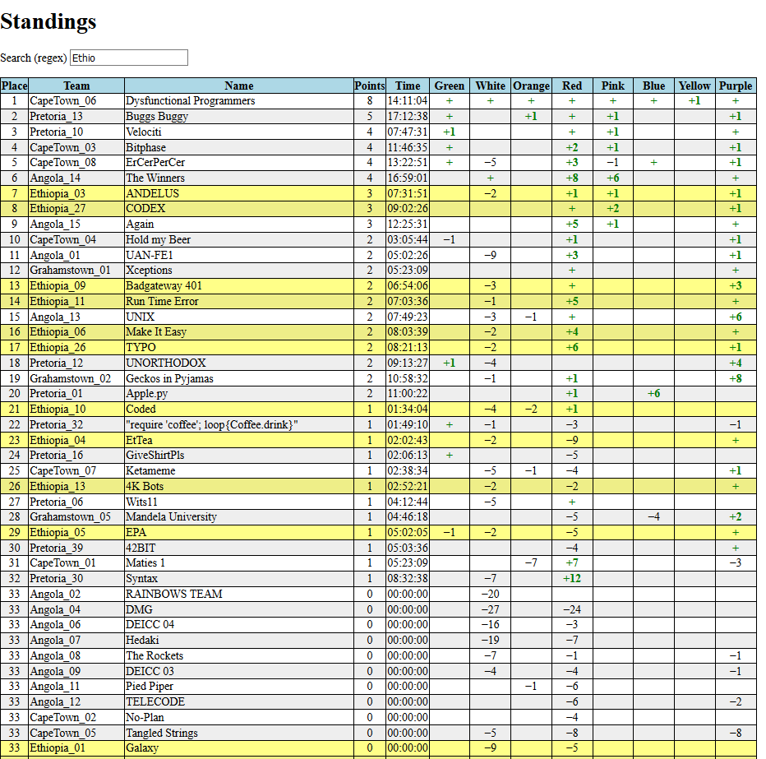
Final Standings of the 20th southafrican regional ICPC

Slide 30
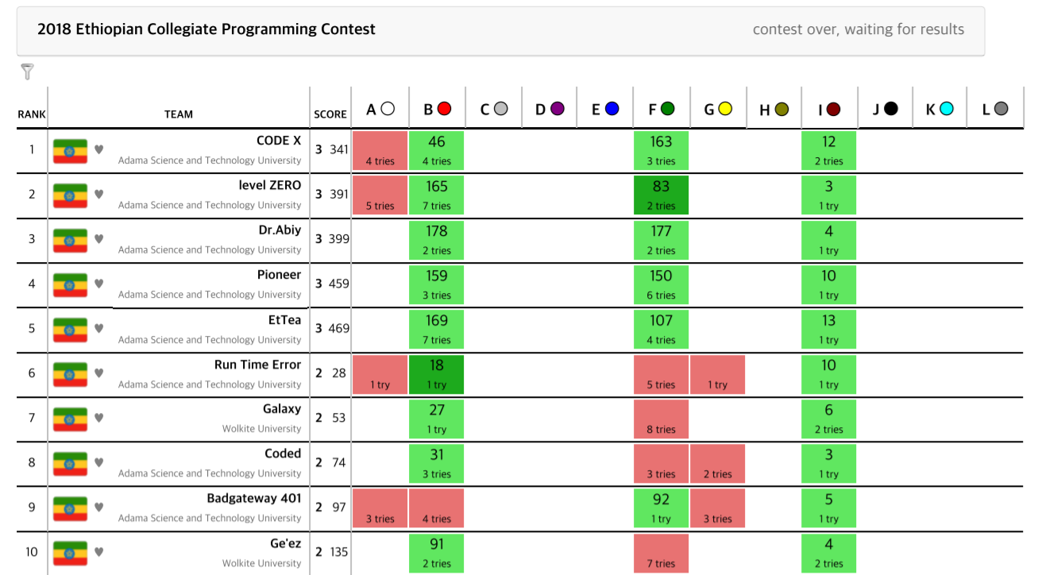
The scoreboard for the 3rd Ethiopian Colligate Programming Contest

Slide 31
#6. The Entrance Exam
It will be conducted on an automated online system called Dom-judge

Slide 32
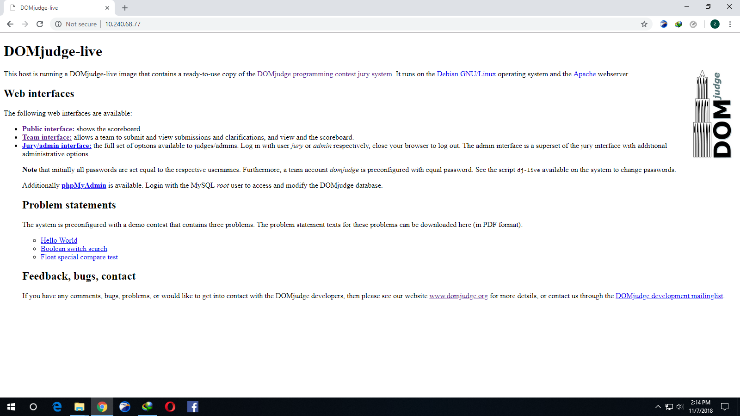

Slide 33
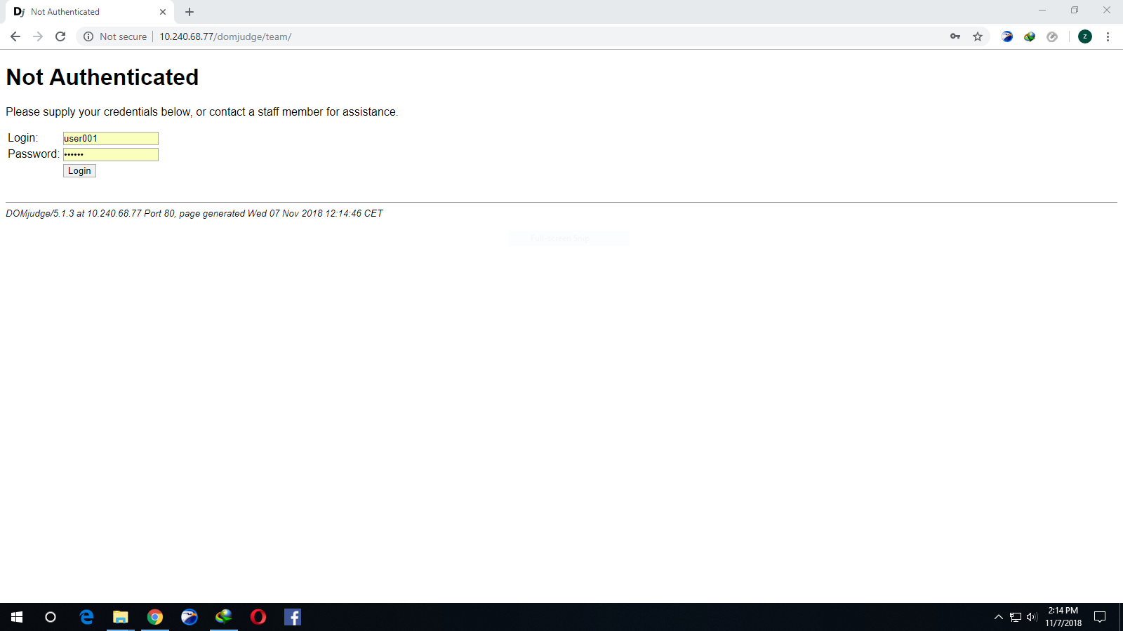

Slide 34
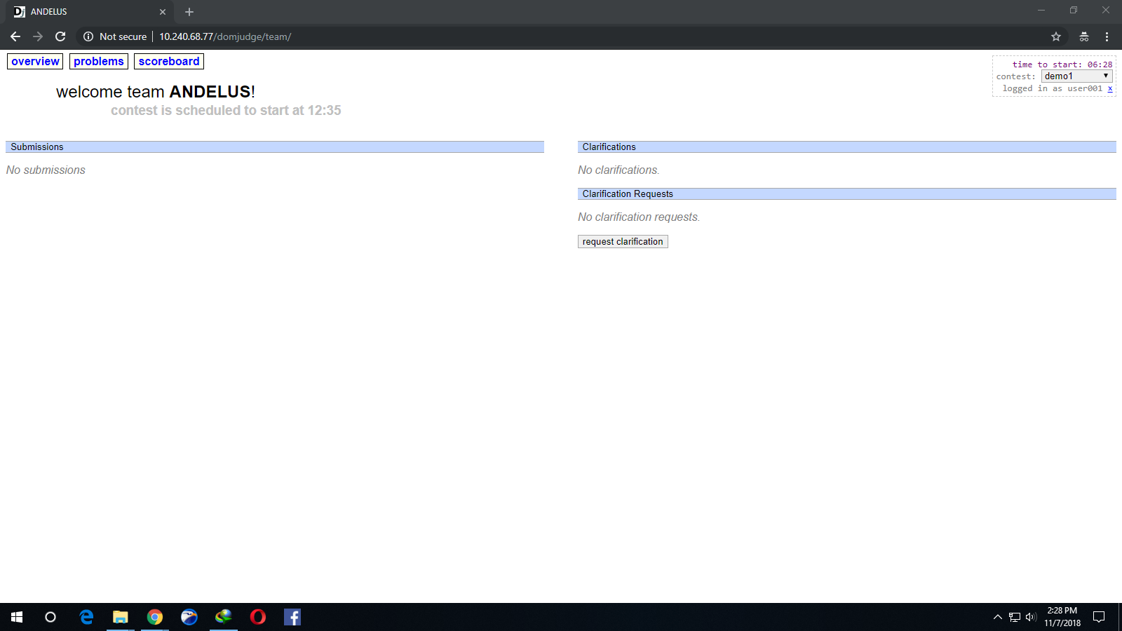

Slide 35
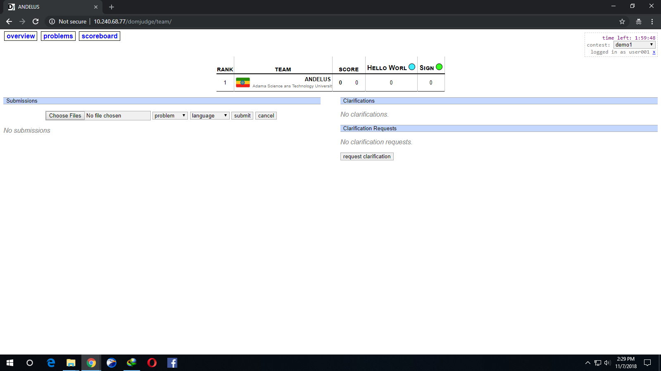

Slide 36
Download the problems by clicking on their name.
Problems have 3 part.
Problem description
Input/output constraint
Sample input/output

Slide 37
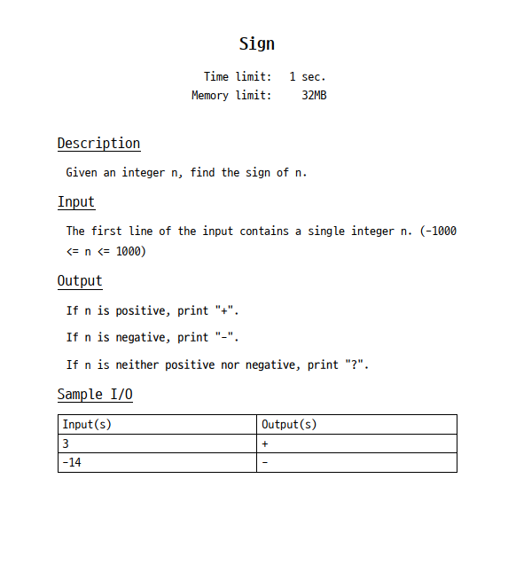

Slide 38
Solve the problem on your computer with c /c++ /java /python
Check for the sample cases.
Go to DOM-judge and submit it.

Slide 39
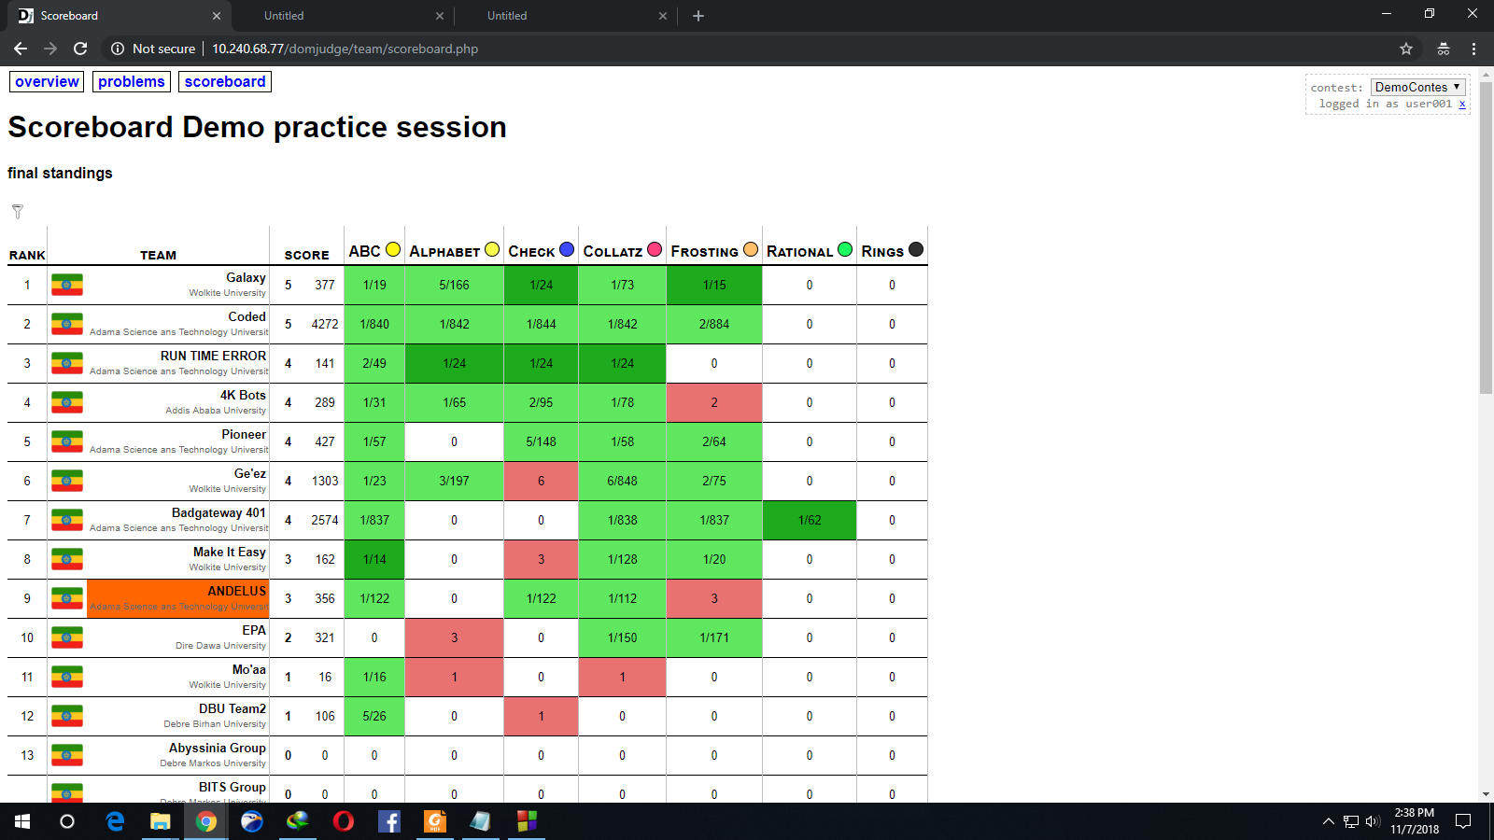

Slide 40
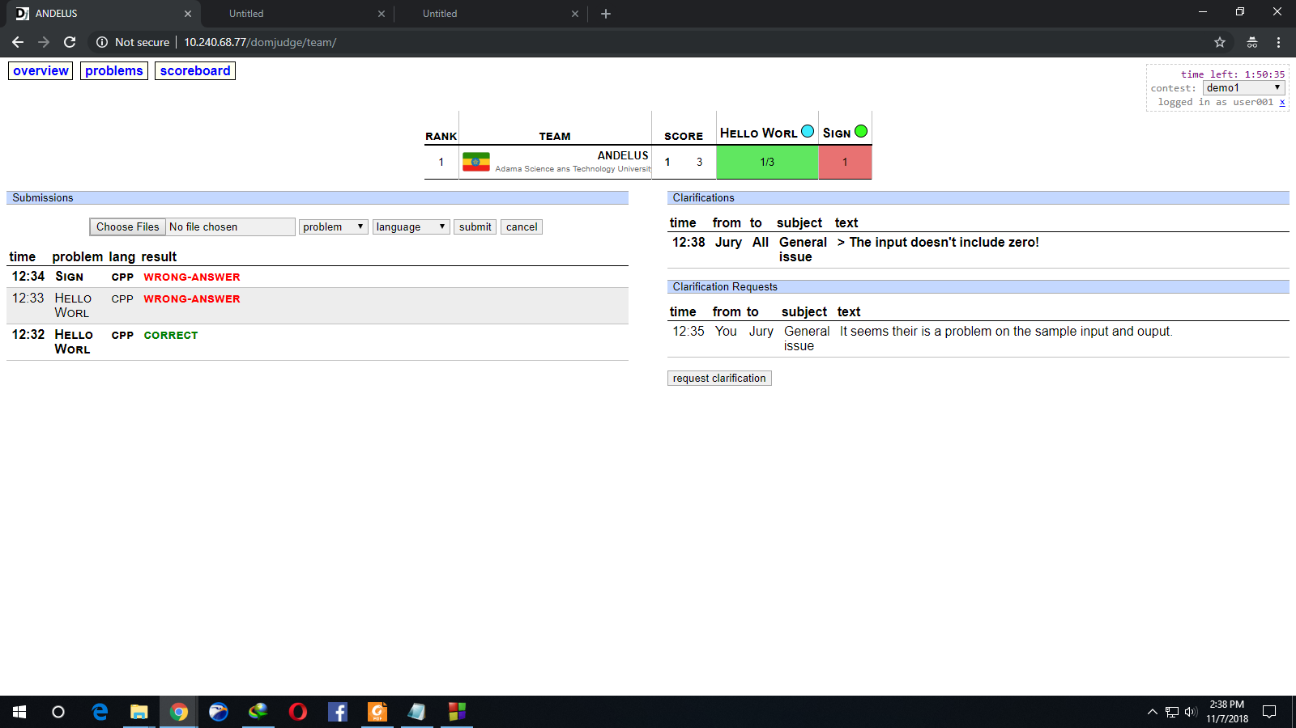

Slide 41
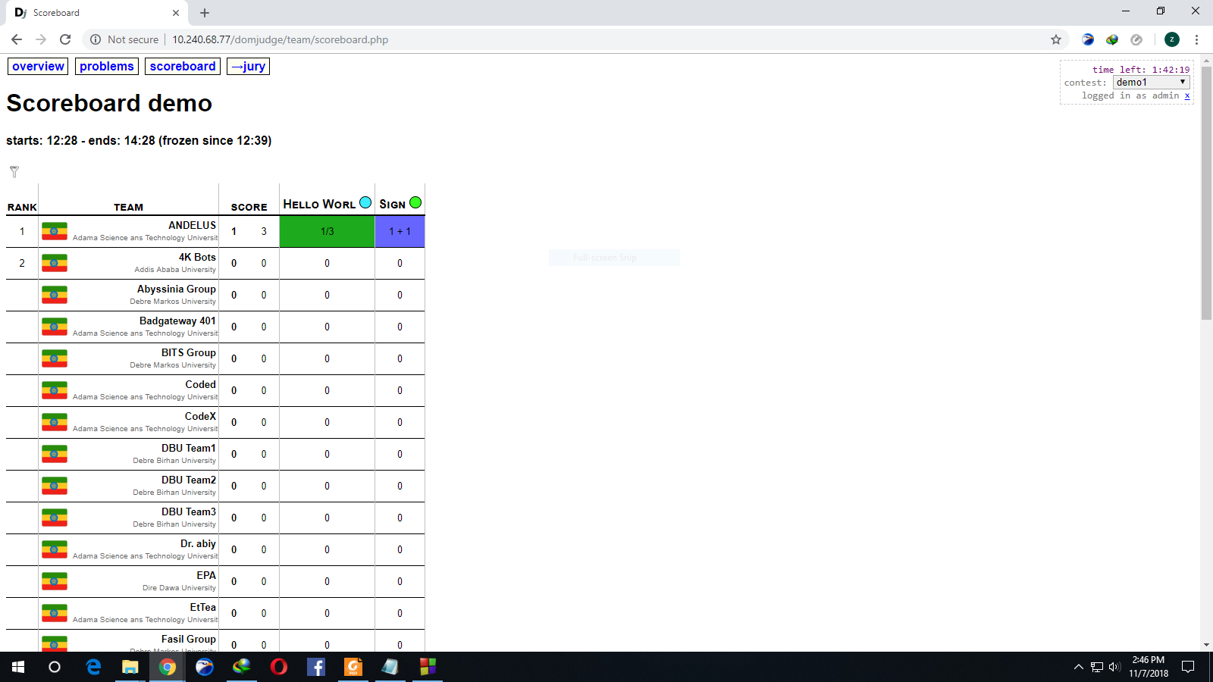

Slide 42
Important Remarks
The entrance exam will start 2:00 Local time sharp
There will be a Mock contest before the actual exam
Be on time, once the exam starts late recruits will be disqualified

Slide 43
T H A N K YOU

